Slide 1
Operating Systems
Lecture 5

Slide 2
Agenda for Today
Review of previous lecture
Browsing UNIX/Linux directory structure
Useful UNIX/Linux commands
Process concept
Process scheduling concepts
Process creation and termination
Recap of the lecture

Slide 3
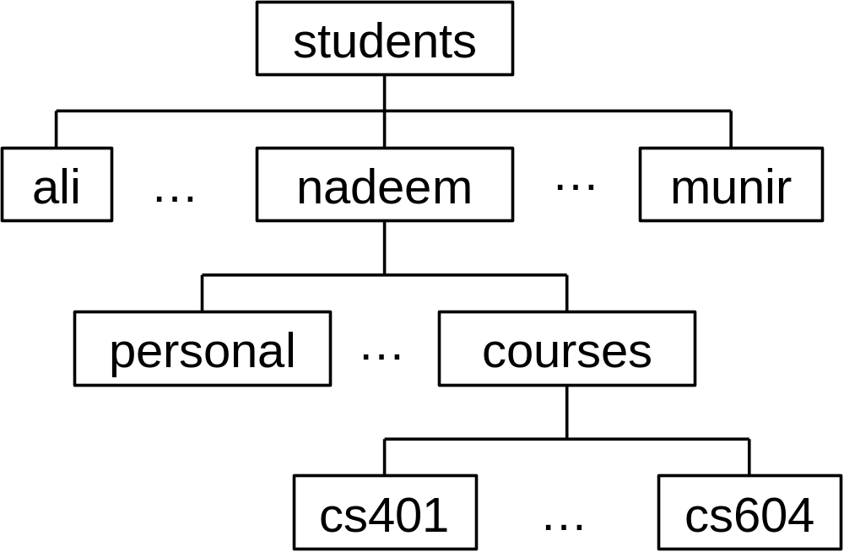
UNIX/Linux Directory Hierarchy

Slide 4
UNIX/Linux Directory Hierarchy
Root directory (/)
Home/login directory (~, $HOME, $home)
Current working directory (.)
Parent of the current working directory (..)

Slide 5
Browsing the File Hierarchy
ls Display contents of a directory
cd Change directory
pwd Print working directory
mkdir Create directory
rmdir Remove directory
cp Copy file
mv Move file
rm Remove file

Slide 6
Browsing the File Hierarchy
ls Display contents of a directory
cd Change directory
pwd Print working directory
mkdir Create directory
rmdir Remove directory
cp Copy file
mv Move file
rm Remove file

Slide 7
Browsing the File Hierarchy
mkdir temp
Create the ‘temp’ directory in your current directory
mkdir ~/courses/cs604/programs
Create the ‘programs’ directory in your ~/courses/cs604 directory
rmkdir ~/courses/cs604/programs Remove the ‘programs’ directory under your ~/courses/cs604 directory

Slide 8
Browsing the File Hierarchy
cp file1 file2
Copy ‘file1’ in your current directory to ‘file2’ in your current directory
cp ~/file1 ~/memos/file2
Copy ‘~/file1’ to ‘~/memos/file2’
mv file1 file2
Move ‘file1’ in your current directory to ‘file2’ in your current directory
mv ~/file1 ~/memos/file2
Move ‘~/file1’ to ‘~/memos/file2’

Slide 9
Browsing the File Hierarchy
rm file1
Remove ‘file1’ from your current directory
rm ~/courses/cs604/programs/test.c
Remove ‘test1’ in the ‘programs’ directory in your ~/courses/cs604 directory
rm *.o
Remove all .o (i.e., object) files from your current directory

Slide 10
Compiling and Running C Programs
$ gcc program.c
$ ../a.out
[ program output ]
$ gcc program.c –o assignment
$ assignment
[ program output ]
$ gcc program.c –o assignment -lm
$ assignment
[ program output ]
$

Slide 11
Useful Internet Resources
UNIX Tutorial for Beginners
  http://www.ee.surrey.ac.uk/Teaching/Unix/
  http://www.isu.edu/departments/comcom/unix/workshop/unixindex.html

Slide 12
Useful Internet Resources
emacs tutorial
  http://www.linuxjunkies.org/programming/IDE/emacs/
vi tutorial
  http://www.networkcomputing.com/unixworld/tutorial/009/009.html
  https://engineering.purdue.edu/ECN/Resources/KnowledgeBase/search_results?query=vi
pico tutorial
  http://www.itd.umich.edu/itdoc/r/r1168/

Slide 13
What is a process?
Process – a program in execution; process execution must progress in sequential fashion.
A process consists of:
  Code (text) section
  Data section
  Stack
  Heap
  Environment
  CPU state (program counter, etc.)
  Process control block (PCB)

Slide 14
CPU and I/O Bound Processes
Processes can be:
  I/O-bound process – spends more time doing I/O than computations, many short CPU bursts.
I/O Burst
CPU Burst
I/O Burst
CPU Burst
  CPU-bound process – spends more time doing computations; few very long CPU bursts.
CPU Burst
I/O
CPU Burst
I/O

Slide 15
Process States
As a process executes, it changes state
  new: The process is being created.
  ready: The process is waiting to be assigned to a processor.
  running: Instructions are being executed.
  waiting: The process is waiting for some event to occur.
  terminated: The process has finished execution.

Slide 16

Process States

Slide 17
Process Control Block (PCB)
Process information and attributes
  Process state
  Program counter
  CPU registers
  CPU scheduling information
  Memory-management information
  Accounting information
  I/O status information
  Per process file table
  Process ID (PID)
  Parent PID, etc.

Slide 18

Process Control Block (PCB)

Slide 19

CPU Switch From Process to Process

Slide 20
Process Scheduling Queues
Job queue – set of all processes in the system.
Ready queue – set of all processes residing in main memory, ready and waiting to execute.
Device queues – set of processes waiting for I/O devices.
Process migration between the various queues.

Slide 21

Queues in the OS

Slide 22

Queues in a Computer System

Slide 23
Schedulers
Long term scheduler
Short term scheduler
Medium term scheduler

Slide 24
Recap of Lecture
Review of previous lecture
Browsing UNIX/Linux directory structure
Useful UNIX/Linux commands
Process concept
Process scheduling concepts

Slide 25
Operating Systems
Lecture 6

Slide 26
Agenda for Today
Review of previous lecture
Process scheduling concepts
Process creation and termination
Process management in UNIX/Linux— system calls: fork, exec, wait, exit
Sample codes
Recap of the lecture

Slide 27
Review of Lecture 5
Browsing the UNIX/Linux directory structure
Useful UNIX/Linux commands
Process concept—attributes, states, types (CPU- and I/O-bound), PCB, OS queues, CPU scheduling, and context switch

Slide 28
Schedulers
Long term scheduler
Short term scheduler
Medium term scheduler

Slide 29
Queues in a Computer System

Slide 30
Long Term Scheduler
Long-term scheduler (or job scheduler) – selects processes from the job pool to be brought into the ready queue.
  Long-term scheduler is invoked very infrequently (seconds, minutes) ⇒ (may be slow).
  The long-term scheduler controls the degree of multiprogramming.
  More processes, smaller percentage of time each process is executed

Slide 31
Short Term Scheduler
Short-term scheduler (or CPU scheduler) – selects which process should be executed next and allocates it the CPU through the dispatcher.
  Short-term scheduler is invoked very frequently (milliseconds) ⇒ (must be fast).
  Invoked when following events occur
    CPU slice of the current process finishes
    Current process needs to wait for an event
    Clock interrupt
    I/O interrupt
    System call
    Signal

Slide 32
Medium Term Scheduler
Also known as swapper
Selects an in-memory process and swaps it out to the disk temporarily
Swapping decision is based on several factors
  Arrival of a higher priority process but no memory available
  Poor mix of jobs
  Memory request of a process cannot be met

Slide 33

Addition of Medium Term Scheduling

Slide 34
Context Switch
When CPU switches to another process, the system must save the state (context) of the ‘current’ (old) process and load the saved state for the new process.
Context-switch time is overhead; the system does no useful work while switching.
Time dependent on hardware support; typically in microseconds

Slide 35
Process Creation
Parent process create children processes, which, in turn create other processes, forming a tree of processes.
Resource sharing
  Parent and children share all resources.
  Children share a subset of parent’s resources.
  Parent and child share no resources.
Execution
  Parent and children execute concurrently.
  Parent waits until children terminate.

Slide 36
Process Creation …
Address space
  Child duplicate of parent.
  Child has a program loaded onto it.
UNIX examples
  fork system call creates a new process
  exec system call used after a fork to replace the process’ memory image with a new executable.

Slide 37

Processes Tree on a UNIX System

Slide 38
Process Termination
Process executes the last statement and requests the operating system to terminate it (exit).
  Output data from child to parent (via wait).
  Process resources are deallocated by the operating system, to be recycled later.

Slide 39
Process Termination …
Parent may terminate execution of children processes (abort).
  Child has exceeded allocated resources (main memory, execution time, etc.).
  Parent needs to create another child but has reached its maximum children limit
  Task performed by the child is no longer required.
  Parent exits.
    Operating system does not allow child to continue if its parent terminates.
    Cascaded termination

Slide 40
Process Management in UNIX/Linux
Important process-related UNIX/Linux system calls
  fork
  wait
  exec
  exit

Slide 41
fork()
When the fork system call is executed, a new process is created which consists of a copy of the address space of the parent.
This mechanism allows the parent process to communicate easily with the child process.
SYNOPSIS #include <sys/types.h> #include <unistd.h> pid_t fork(void);

Slide 42
fork() ...
The return code for fork is zero for the child process and the process identifier of child is returned to the parent process.
On success, both processes continue execution at the instruction after the fork call.
On failure, -1 is returned to the parent process and errno is set appropriately to indicate the reason of failure; no child is created

Slide 43
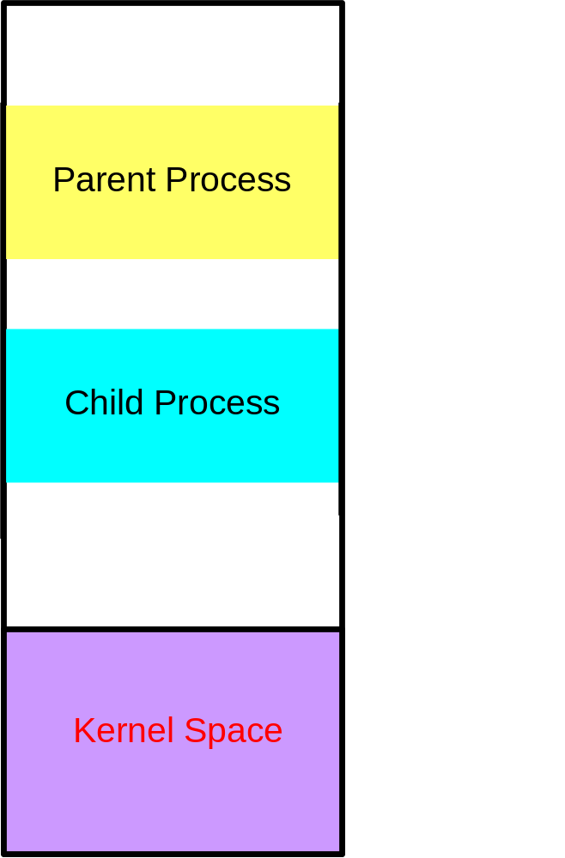
fork()—Sample Code
main()
{
int pid;
...
pid = fork();
if (pid == 0) {
/* Code for child */
...
}
else {
/* Code for parent */
...
}
...
}

Slide 44
fork()—Inherits from the Parent
The child process inherits the following attributes from the parent:
  Environment
  Open file descriptor table
  Signal handling settings
  Nice value
  Current working directory
  Root directory
  File mode creation mask (umask)
  Etc.

Slide 45
fork()—Child Differs from the Parent
The child process differs from the parent process:
  Different process ID (PID)
  Different parent process ID (PPID)
  Child has its own copy of parent’s file descriptors
  Etc.

Slide 46
fork()—Reasons for Failure
Maximum number of processes allowed to execute under one user has exceeded
Maximum number of processes allowed on the system has exceeded
Not enough swap space

Slide 47
Recap of Lecture
Review of previous lecture
Process scheduling concepts
Process creation and termination
Process management in UNIX/Linux— system calls: fork, wait, exit
Sample codes
Recap of the lecture

Slide 48
Operating Systems
Lecture 7

Slide 49
Agenda for Today
Review of previous lecture
The wait and exec system calls and sample code
Cooperating processes
Producer-consumer problem
Interprocess communication (IPC) and process synchronization
Recap of the lecture

Slide 50
Review of Lecture 6
Schedulers (long-, and short-, and medium-term)
Dispatcher
Process creation and termination
fork and exit system calls

Slide 51
wait()
The wait system call suspends the calling process until one of its immediate children terminates, or until a child that is being traced stops because it has hit an event of interest.
wait returns prematurely if a signal is received. If all children processes stopped or terminated prior to the call on wait, return is immediate.

Slide 52
Synopsis of wait()
#include <sys/types.h> #include <sys/wait.h> pid_t wait(int *stat_loc); <sys/types.h>: /usr/include/sys/types.h

Slide 53
wait() ...
If the call is successful, the process ID of the terminating child is returned.
If parent terminates all its children have assigned as their new parent, the init process. Thus the children still have a parent to collect their status and execution statistics.

Slide 54
wait() ...
Zombie process—a process that has terminated but whose exit status has not yet been received by its parent process or by init.

Slide 55
Sample Code—fork
#include <stdio.h> void main() { int pid, status; pid = fork(); if(pid == -1) { printf(“fork failed\n”); exit(1); }

Slide 56
Sample Code—fork
if(pid == 0) { /* Child */ printf(“Child here!\n”); exit(0); } else { /* Parent */ wait(&status); printf(“Well done kid!\n”); exit(0); } }

Slide 57
Semantics of fork
P
fork
P

Slide 58
exec()
Typically the exec system call is used after a fork system call by one of the two processes to replace the process’ memory space with a new executable program.
The new process image is constructed from an ordinary, executable file.

Slide 59
exec()
There can be no return from a successful exec because the calling process image is overlaid by the new process image

Slide 60
Synopsis of exec()
#include <unistd.h> int execlp (const char *file, const char *arg0, ..., const char *argn, (char *)0);

Slide 61
Sample Code—fork and exec
#include <stdio.h> void main() { int pid, status; pid = fork(); if(pid == -1) { printf(“fork failed\n”); exit(1); }

Slide 62
Sample Code—fork and exec
if(pid == 0) { /* Child */ if (execlp(“/bin/ls”, “ls”, NULL)< 0) { printf(“exec failed\n”); exit(1); } } else { /* Parent */ wait(&status); printf(“Well done kid!\n”); exit(0); } }

Slide 63
Semantics of fork
parent
parent
parent
P
P
P
fork
P
P
ls
ls
exec
child
child
child
1
2
3

Slide 64

Cooperating Processes
Independent process cannot affect or be affected by the execution of another process.
Cooperating process can affect or be affected by the execution of another process

Slide 65
Cooperating Processes
Advantages of process cooperation
  Information sharing
  Computation speed-up
  Modularity
  Convenience

Slide 66
Producer-Consumer Problem
Paradigm for cooperating processes, producer process produces information that is consumed by a consumer process.
  unbounded-buffer places no practical limit on the size of the buffer
  bounded-buffer assumes that there is a fixed buffer size

Slide 67
Bounded-Buffer Problem
Empty Pool
Producer
Consumer
Full Pool

Slide 68
Bounded-Buffer Solution
Shared data
      #define BUFFER_SIZE 10
      typedef struct {
      . . .
      } item;
      item buffer[BUFFER_SIZE];
      int in = 0;
      int out = 0;
Solution is correct, but can only use BUFFER_SIZE-1 elements

Slide 69
Producer Process
item nextProduced; while (1) { while (((in + 1) % BUFFER_SIZE) == out) ; /* do nothing */ buffer[in] = nextProduced; in = (in + 1) % BUFFER_SIZE; }

Slide 70
Consumer Process
item nextConsumed; while (1) { while (in == out) ; /* do nothing */ nextConsumed = buffer[out]; out = (out + 1) % BUFFER_SIZE; }

Slide 71
Interprocess Communication (IPC)
Mechanism for processes to communicate and to synchronize their actions.
Message system – processes communicate with each other without resorting to shared variables.

Slide 72
Interprocess Communication (IPC)
IPC facility provides two operations:
  Send (message) – message size fixed or variable
  Receive (message)

Slide 73
Interprocess Communication (IPC)
If P and Q wish to communicate, they need to:
  establish a communication link between them
  exchange messages via send/receive

Slide 74
Interprocess Communication (IPC)
Implementation of communication link
  physical (e.g., shared memory, hardware bus)
  logical (e.g., logical properties)

Slide 75
Implementation Questions
How are links established?
Can a link be associated with more than two processes?
How many links can there be between every pair of communicating processes?

Slide 76
Implementation Questions
What is the capacity of a link?
Is the size of a message that the link can accommodate fixed or variable?
Is a link unidirectional or bi-directional?

Slide 77
Direct Communication
Processes must name each other explicitly:
  send (P, message) – send a message to process P
  Receive (Q, message) – receive a message from process Q

Slide 78
Direct Communication
Properties of communication link
  Links are established automatically.
  A link is associated with exactly one pair of communicating processes.
  Between each pair there exists exactly one link.
  The link may be unidirectional, but is usually bi-directional.

Slide 79

Indirect Communication
Messages are directed and received from mailboxes (also referred to as ports).
  Each mailbox has a unique id.
  Processes can communicate only if they share a mailbox.

Slide 80
Indirect Communication …
Properties of communication link
  Link established only if processes share a common mailbox
  A link may be associated with many processes.
  Each pair of processes may share several communication links.
  Link may be unidirectional or bi-directional.

Slide 81
Indirect Communication …
Operations
  create a new mailbox
  send and receive messages through mailbox
  destroy a mailbox
Primitives are defined as:
send (A, message)
receive (A, message)

Slide 82
Indirect Communication …
Mailbox sharing
  P₁, P₂, and P₃ share mailbox A.
  P₁, sends; P₂ and P₃ receive.
  Who gets the message?

Slide 83
Indirect Communication …
Solutions
  Allow a link to be associated with at most two processes.
  Allow only one process at a time to execute a receive operation.
  Allow the system to select arbitrarily the receiver. Sender is notified who the receiver was.

Slide 84
Synchronization
Message passing may be either blocking or non-blocking.
Blocking is considered synchronous
Non-blocking is considered asynchronous
send and receive primitives may be either blocking or non-blocking.

Slide 85
Buffering
Queue of messages attached to the link; implemented in one of three ways.
Zero capacity – No messages Sender must wait for receiver
Bounded capacity – n messages
Sender must wait if link full.
Unbounded capacity – infinite length
Sender never waits.

Slide 86
Recap of Lecture
Review of previous lecture
The wait and exec system call and sample code
Cooperating processes
Producer-consumer problem
Sample codes
Interprocess communication (IPC) and process synchronization
Recap of the lecture

Slide 87
Operating Systems
Lecture 8

Slide 88
Agenda for Today
Review of previous lecture
Interprocess communication (IPC) and process synchronization
UNIX/Linux IPC tools (pipe, named pipe—FIFO, socket, message queue, shared memory)
Use of pipe
Recap of the lecture

Slide 89
Review of Lecture 7
The wait and exec system calls and sample code
Cooperating processes
Producer-consumer problem

Slide 90
Interprocess Communication (IPC)
Mechanism for processes to communicate and to synchronize their actions.
Message system – processes communicate with each other without resorting to shared variables.

Slide 91
Interprocess Communication (IPC)
IPC facility provides two operations:
  Send (message) – message size fixed or variable
  Receive (message)

Slide 92
Interprocess Communication (IPC)
If P and Q wish to communicate, they need to:
  establish a communication link between them
  exchange messages via send/receive

Slide 93
Interprocess Communication (IPC)
Implementation of communication link
  physical (e.g., shared memory, hardware bus)
  logical (e.g., logical properties)

Slide 94
Implementation Questions
How are links established?
Can a link be associated with more than two processes?
How many links can there be between every pair of communicating processes?

Slide 95
Implementation Questions
What is the capacity of a link?
Is the size of a message that the link can accommodate fixed or variable?
Is a link unidirectional or bi-directional?

Slide 96
Direct Communication
Processes must name each other explicitly:
  send (P, message) – send a message to process P
  Receive (Q, message) – receive a message from process Q

Slide 97
Direct Communication
Properties of communication link
  Links are established automatically.
  A link is associated with exactly one pair of communicating processes.
  Between each pair there exists exactly one link.
  The link may be unidirectional, but is usually bi-directional.

Slide 98
Indirect Communication
Messages are directed and received from mailboxes (also referred to as ports).
  Each mailbox has a unique id.
  Processes can communicate only if they share a mailbox.

Slide 99
Indirect Communication …
Properties of communication link
  Link established only if processes share a common mailbox
  A link may be associated with many processes.
  Each pair of processes may share several communication links.
  Link may be unidirectional or bi-directional.

Slide 100
Indirect Communication …
Operations
  create a new mailbox
  send and receive messages through mailbox
  destroy a mailbox
Primitives are defined as:
send (A, message)
receive (A, message)

Slide 101
Indirect Communication …
Mailbox sharing
  P₁, P₂, and P₃ share mailbox A.
  P₁, sends; P₂ and P₃ receive.
  Who gets the message?

Slide 102
Indirect Communication …
Solutions
  Allow a link to be associated with at most two processes.
  Allow only one process at a time to execute a receive operation.
  Allow the system to select arbitrarily the receiver. Sender is notified who the receiver was.

Slide 103
Synchronization
Message passing may be either blocking or non-blocking.
Blocking is considered synchronous
Non-blocking is considered asynchronous
send and receive primitives may be either blocking or non-blocking.

Slide 104
Buffering
Queue of messages attached to the link; implemented in one of three ways.
Zero capacity – No messages Sender must wait for receiver
Bounded capacity – n messages
Sender must wait if link full.
Unbounded capacity – infinite length
Sender never waits.

Slide 105
UNIX/Linux IPC Tools
Pipe
Named pipe (FIFO)
BSD Socket
TLI
Message queue
Shared memory
Etc.

Slide 106
UNIX/Linux Pipe
Important system calls
pipe, read, write, close
pipe: Create a pipe for IPC
read: Read from a pipe
write: Write data to a pipe
close: Close/destroy a pipe

Slide 107
File Descriptors in UNIX/Linux
An integer returned by open() system call
Used as an index in the per process file descriptor table (PPFDT)
Used in read, write, and close calls

Slide 108
File Descriptors in UNIX/Linux
Size of PPFDT is equal to the number of files that a process can open simultaneously (OPEN_MAX in Linux—see <linux/limits.h>
Used as an index in the per process file descriptor table (PPFDT)
Used in read, write, and close calls

Slide 109
UNIX/Linux Pipe
Important characteristics of a pipe
  Stream of bytes
  Used as half-duplex channel
  Bounded buffer
  Maximum data written is PIPE_BUF (defined in <sys/param.h> under UNIX and in <linux/param.h> in Linux)—5120 and 4096, respectively

Slide 110
Synopsis of pipe System Call
#include <unistd.h> int pipe (int filedes[2]);

Slide 111
Example
child
parent
fork
P
P
Read end
Write end

Slide 112
Sample Code
/* Parent creates pipe, forks a child, child writes into
pipe, and parent reads from pipe */
#include <stdio.h>
#include <sys/types.h>
#include <sys/wait.h>
main()
{
int pipefd[2], pid, n, rc, nr, status;
char *testString = "Hello, world!\n“, buf[1024];

Slide 113
Sample Code
rc = pipe (pipefd);
if (rc < 0) {
perror("pipe");
exit(1);
}
pid = fork ();
if (pid < 0) {
perror("fork");
exit(1);
}

Slide 114
Sample Code
if (pid == 0) { /* Child’s Code */
close(pipefd[0]);
write(pipefd[1], testString, strlen(testString));
close(pipefd[1]);
exit(0);
}

Slide 115
Sample Code
/* Parent’s Code */
close(pipefd[1]);
n = strlen(testString);
nr = read(pipefd[0], buf, n);
rc = write(1, buf, nr);
wait(&status);
printf("Good work child!\n");
return(0);

Slide 116
Recap of Lecture
Review of previous lecture
Interprocess communication (IPC) and process synchronization
UNIX/Linux IPC tools (pipe, FIFO, socket, message queue, shared memory, etc.)
Use of UNIX pipe
Recap of the lecture

